Slide 1
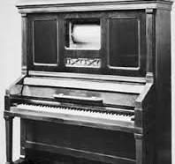
Player Piano
Laura Green
IoT Cohort 10

Slide 2
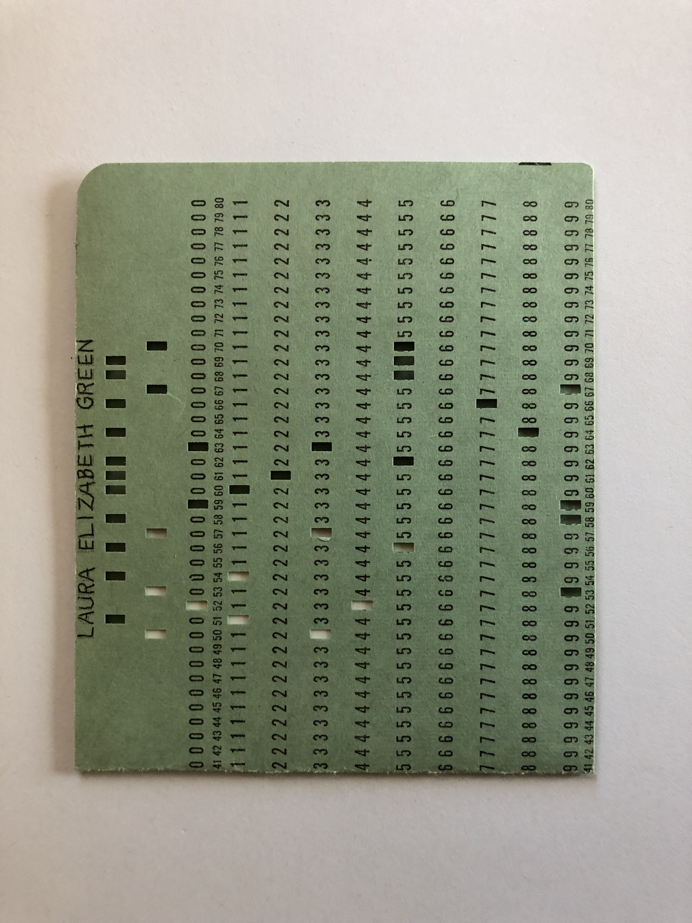
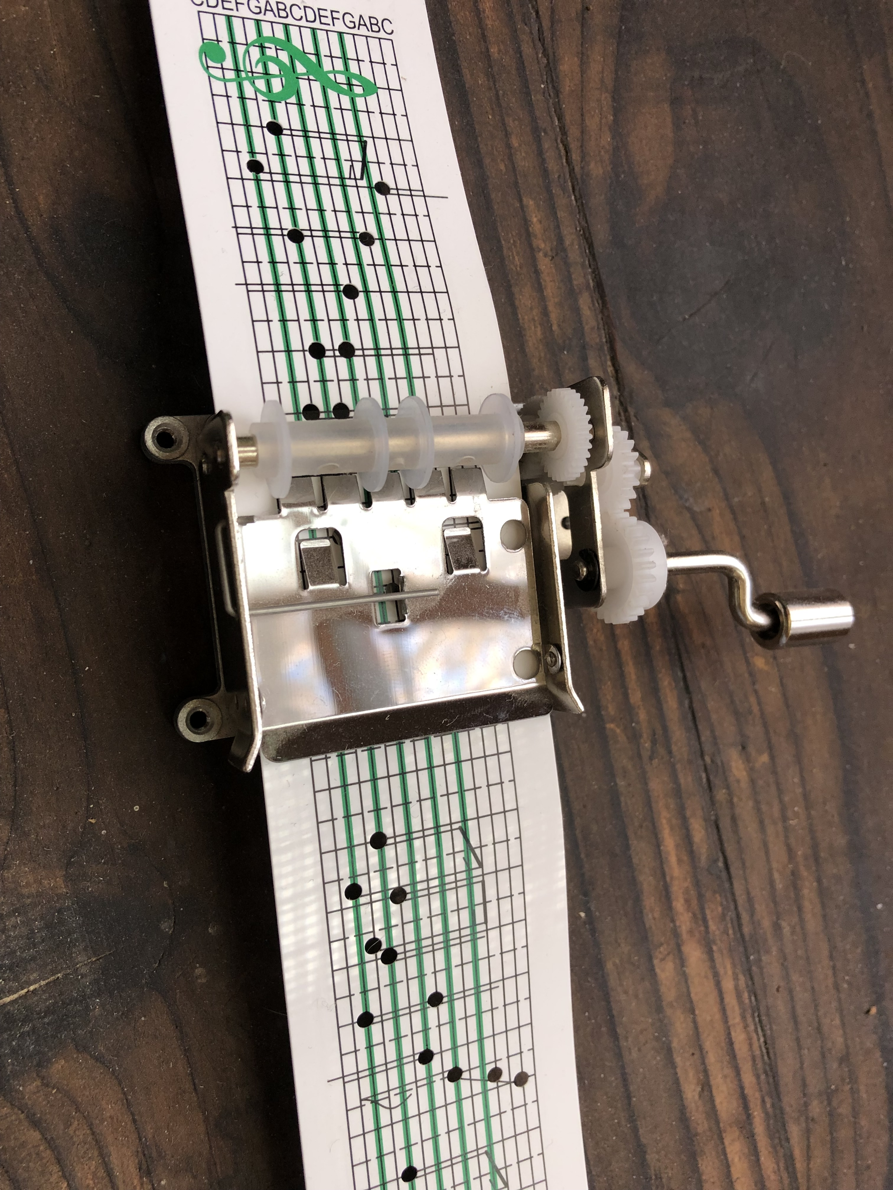
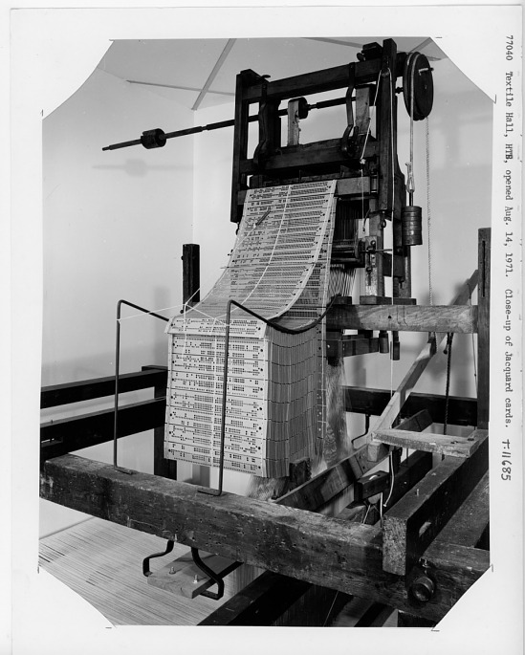
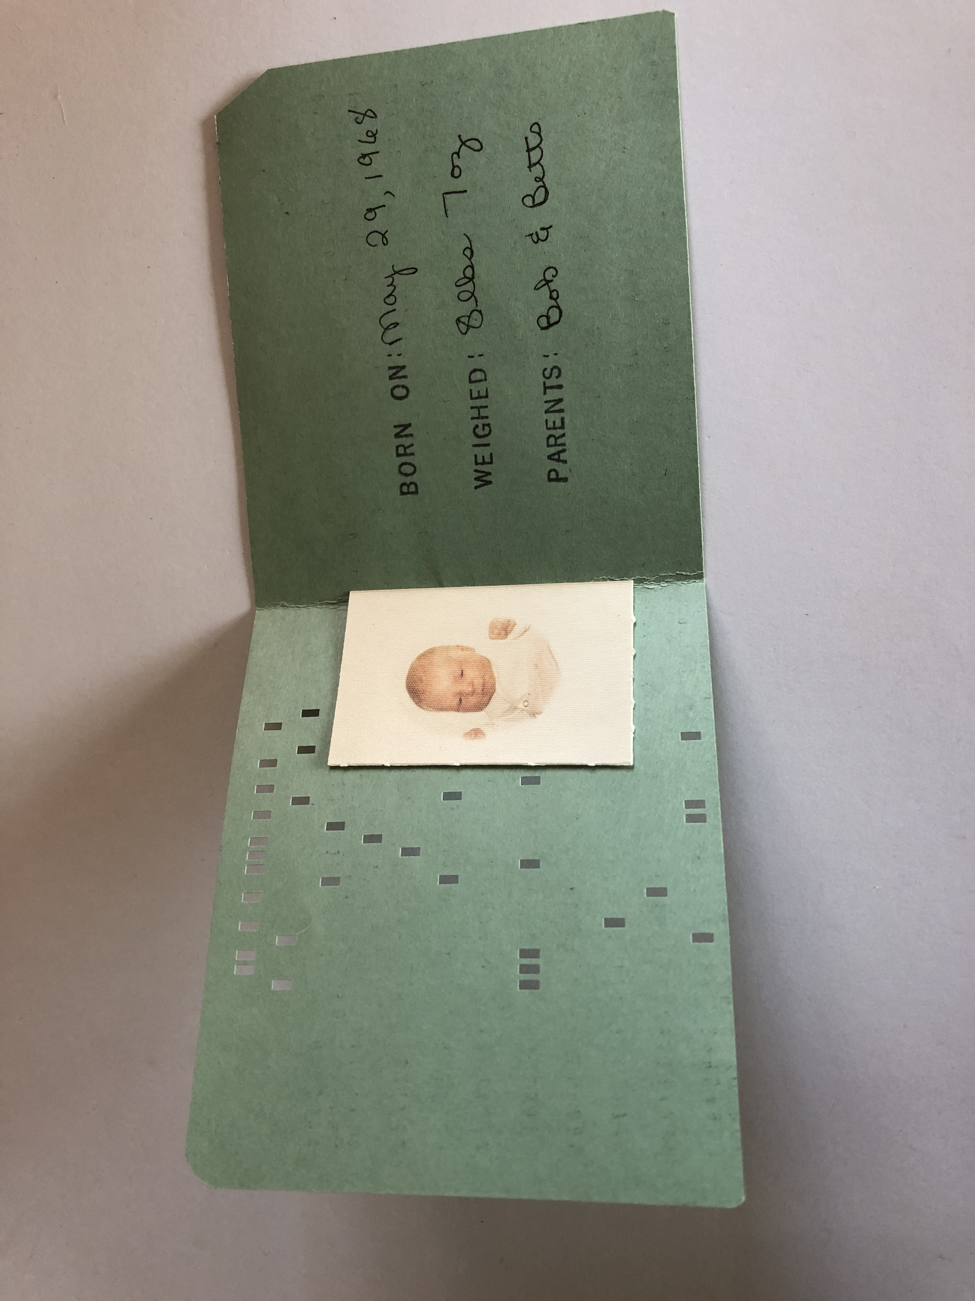
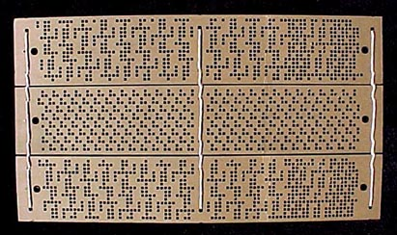
Inspirations:

Slide 3
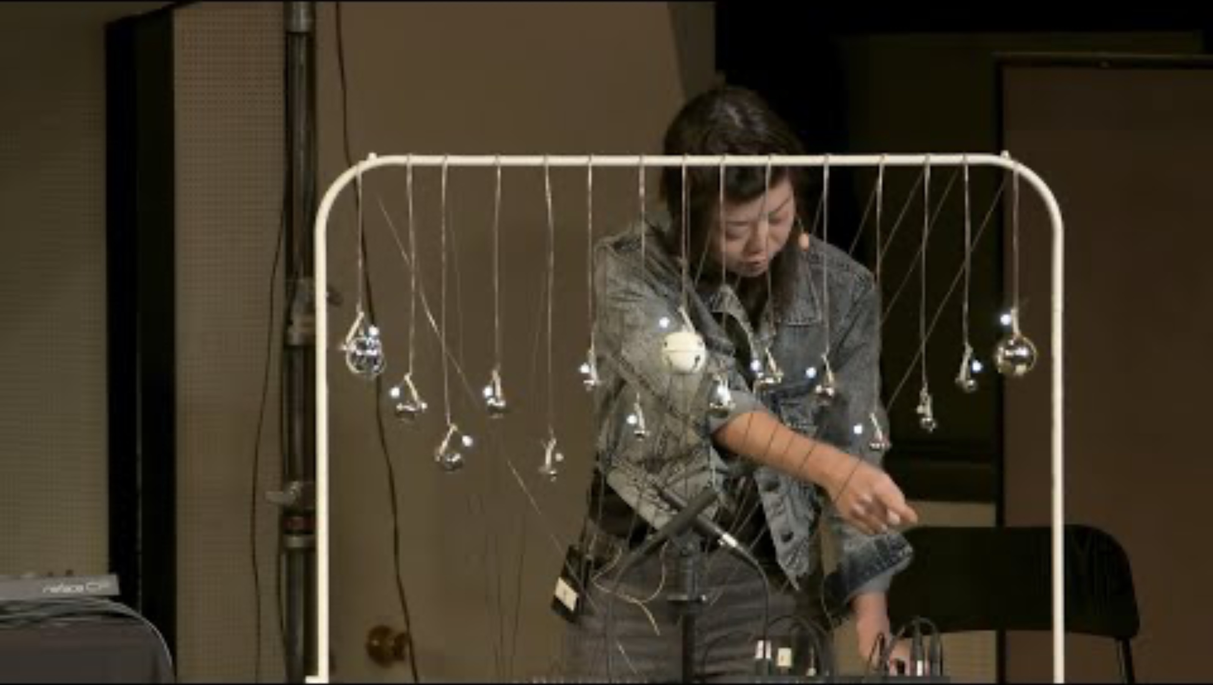
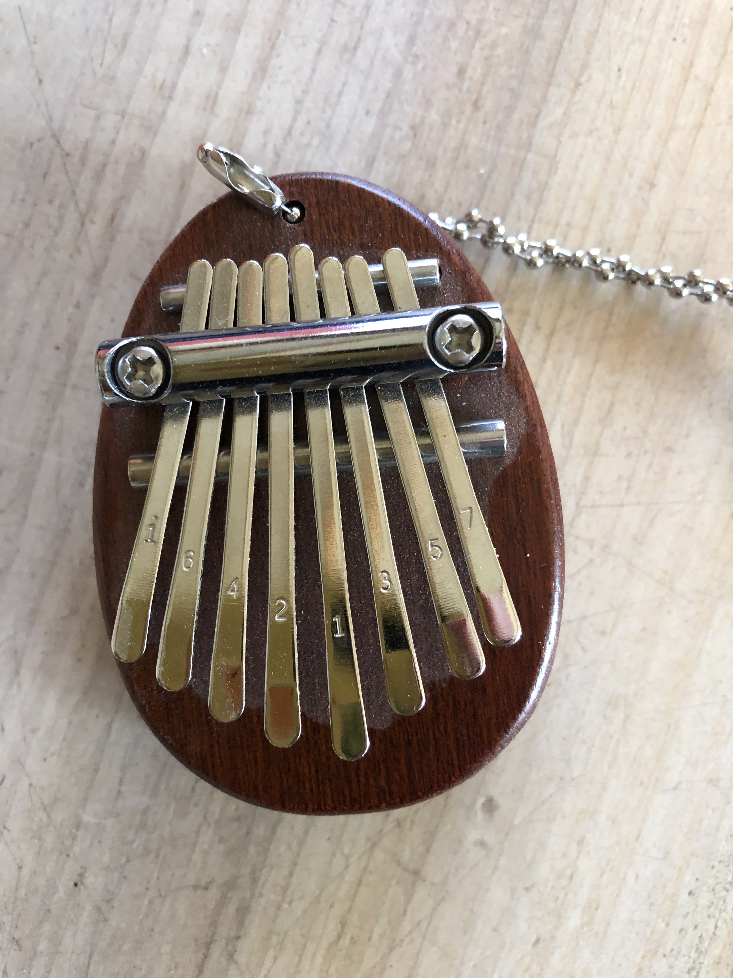
Hybrids:
Idea for someday…..
“Touch, Code, Play: Creating Hybrid physical-digital Music Instruments/ Loop”

Slide 4
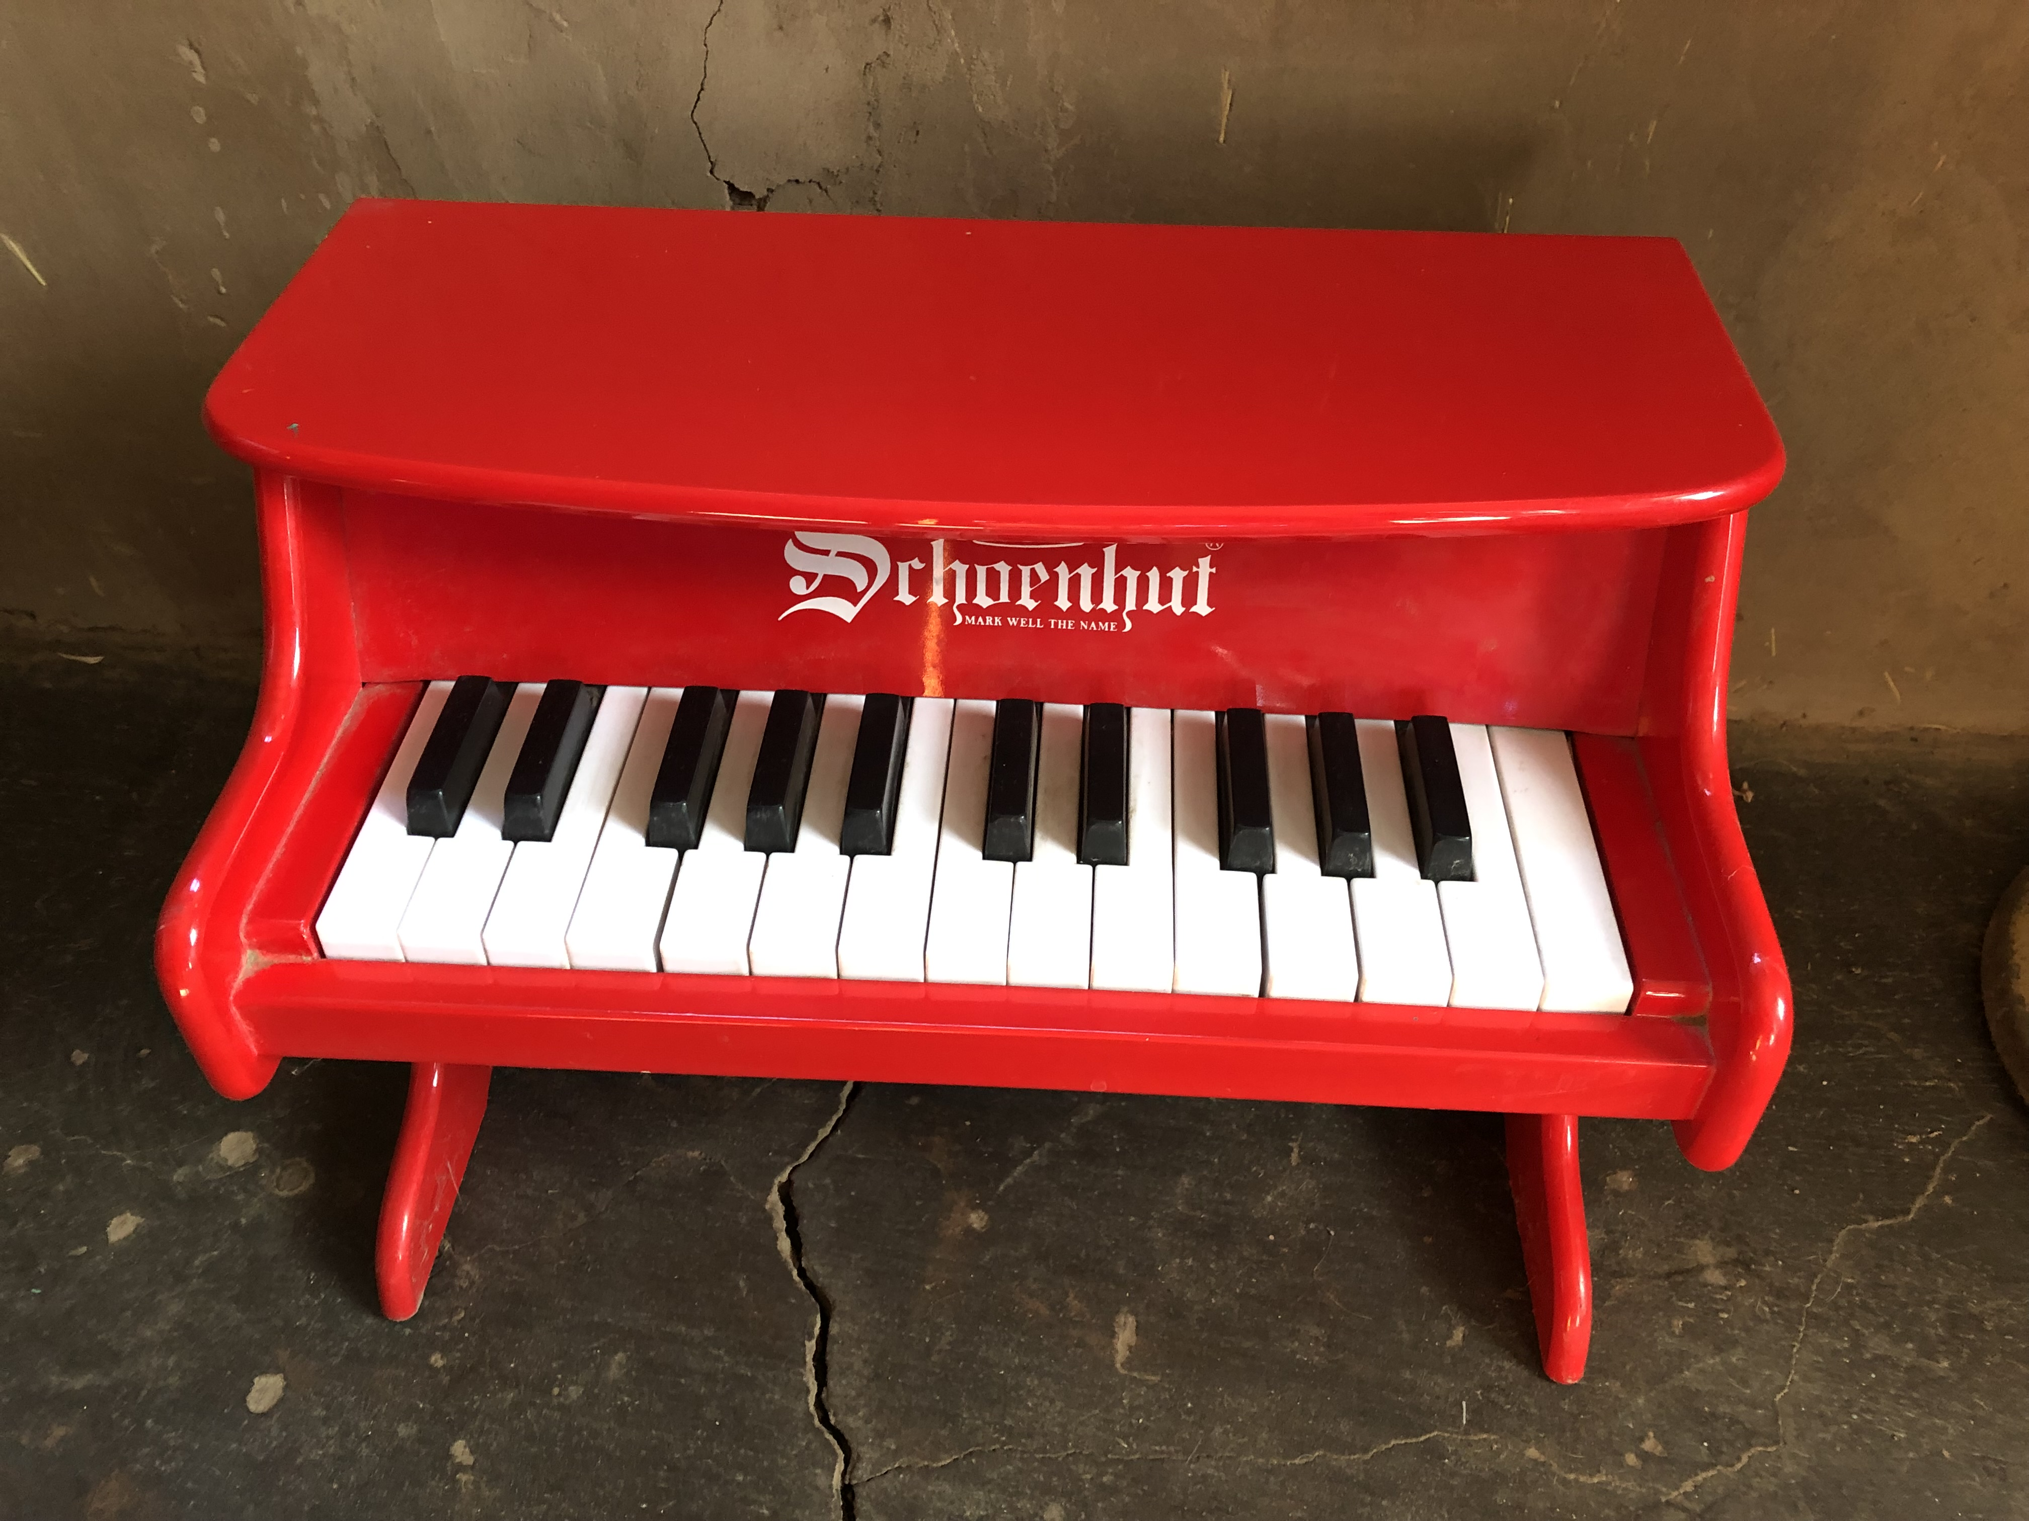
Aesthetic:

Slide 5
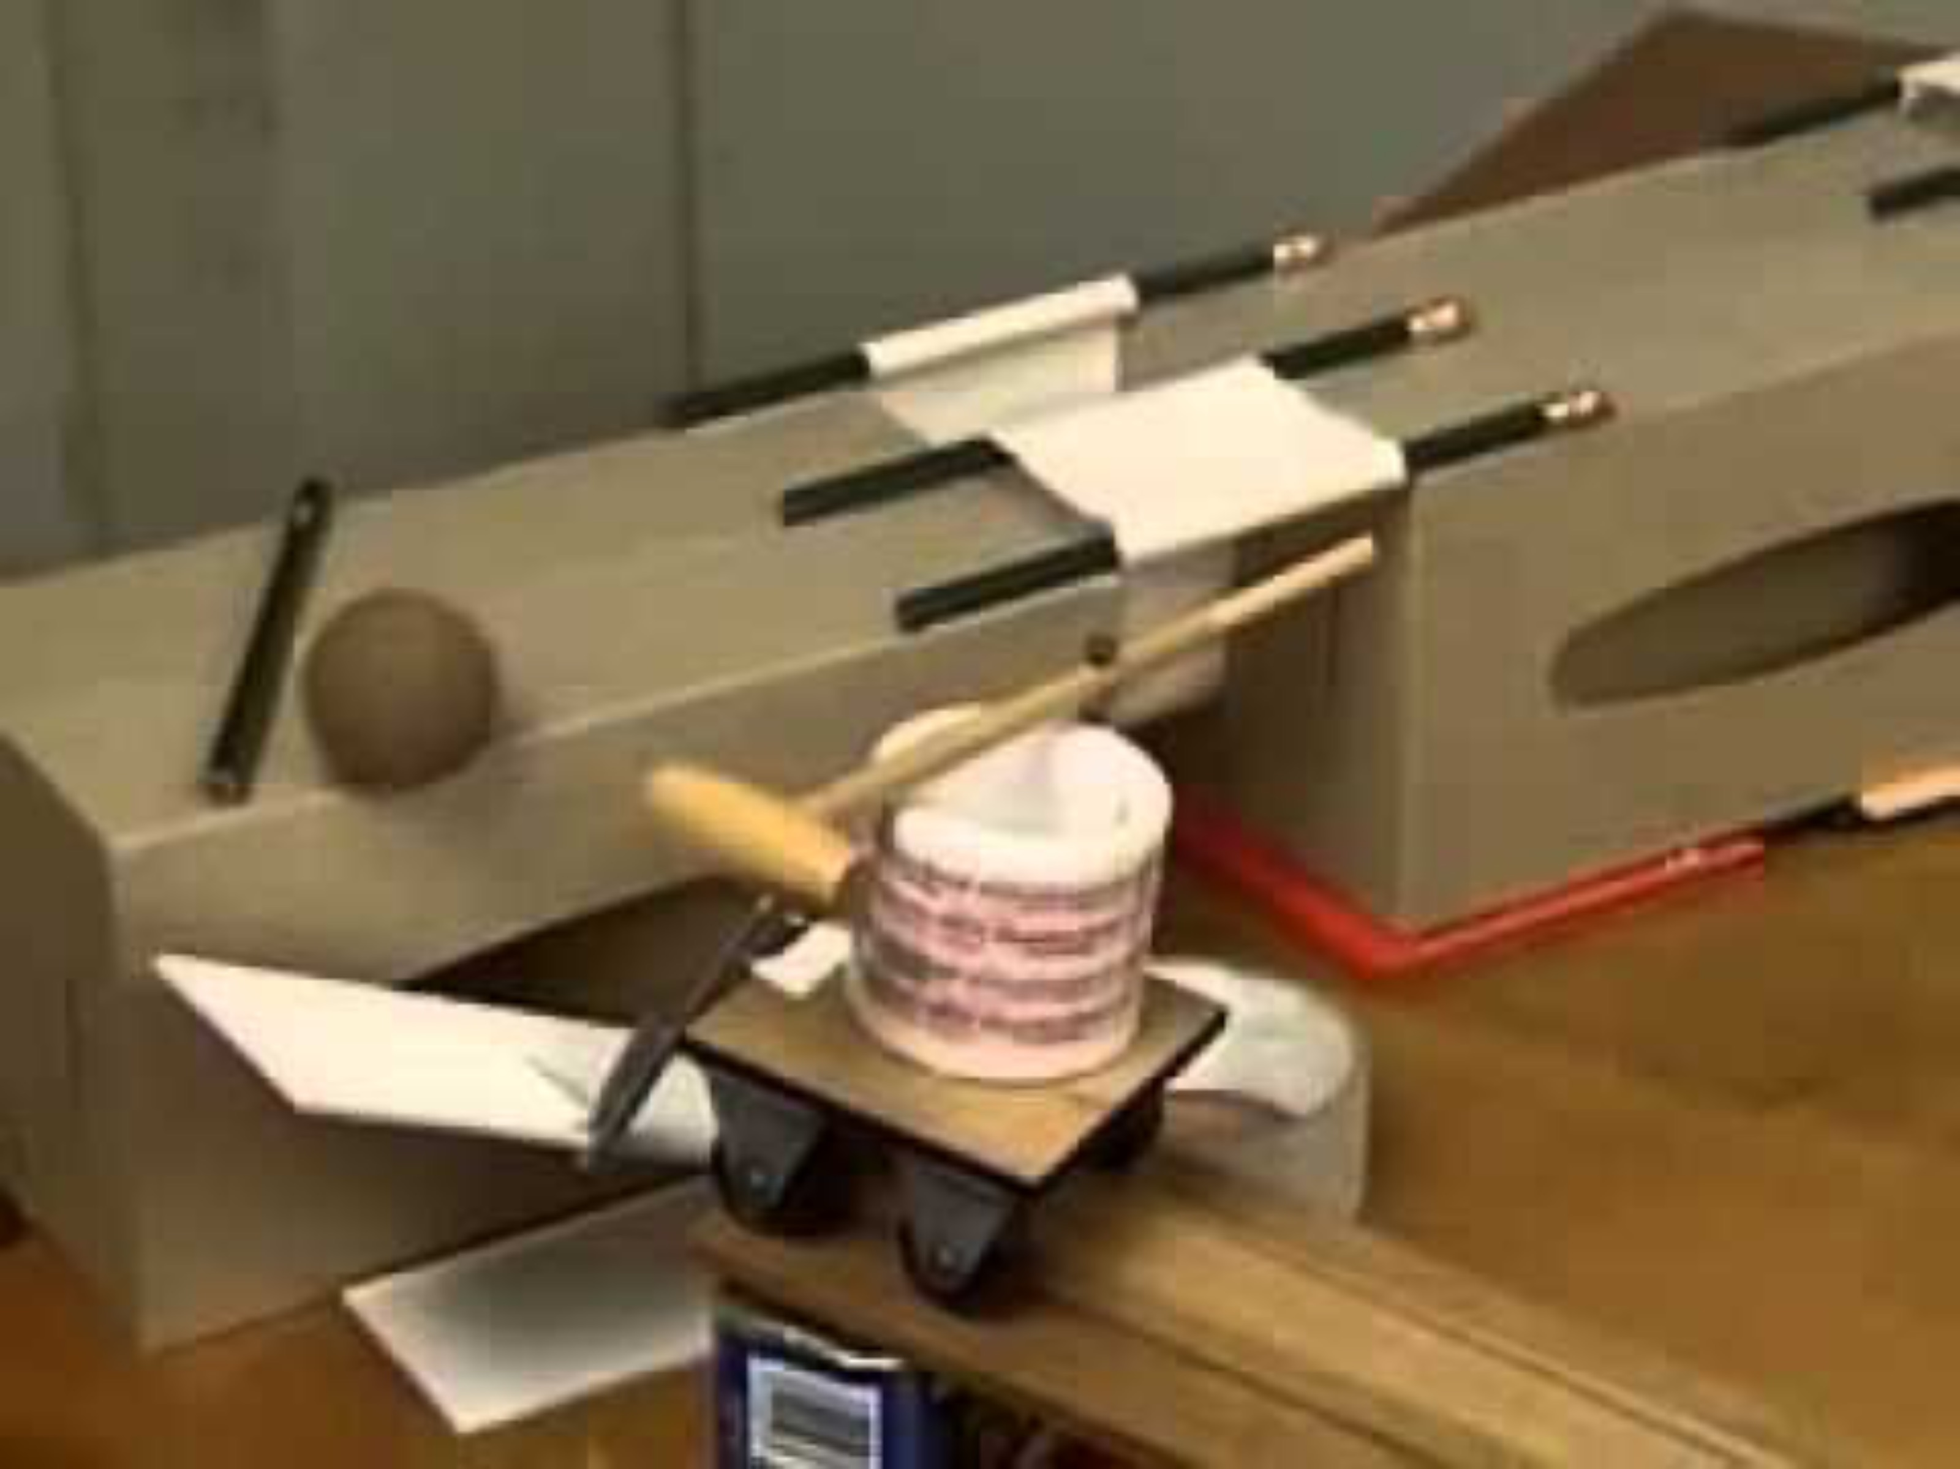
Cascade, unnecessary steps, what’s manual/automatic
Initial flowchart:
Rube Goldberg and chain reactions:

Slide 6
How it ended up:

Slide 7
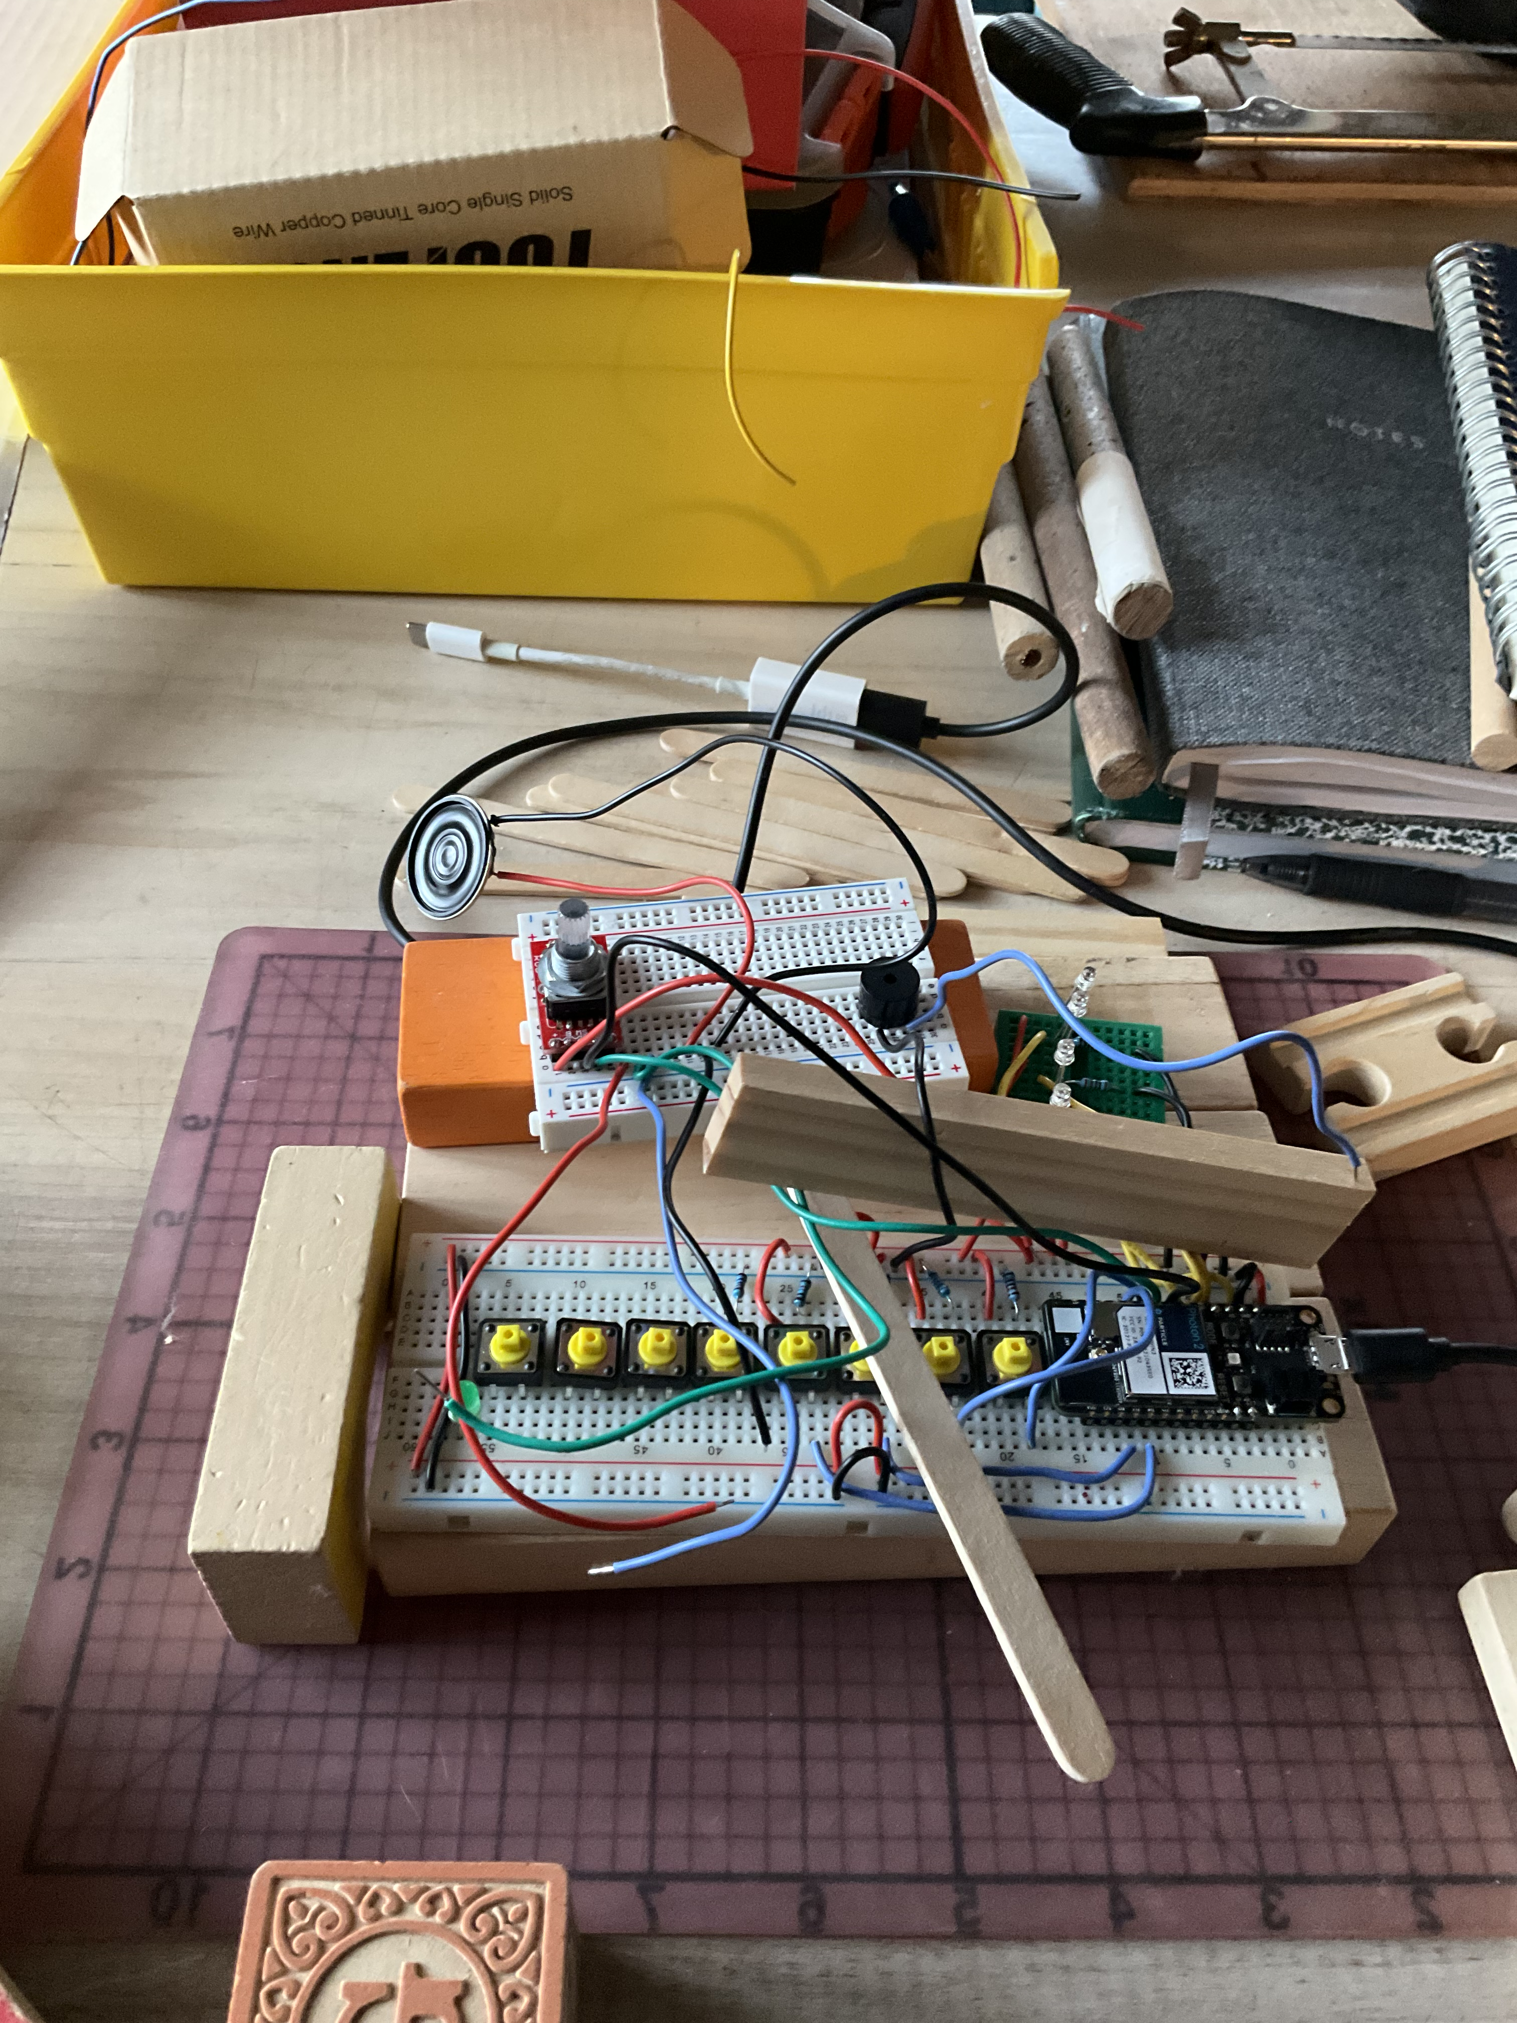
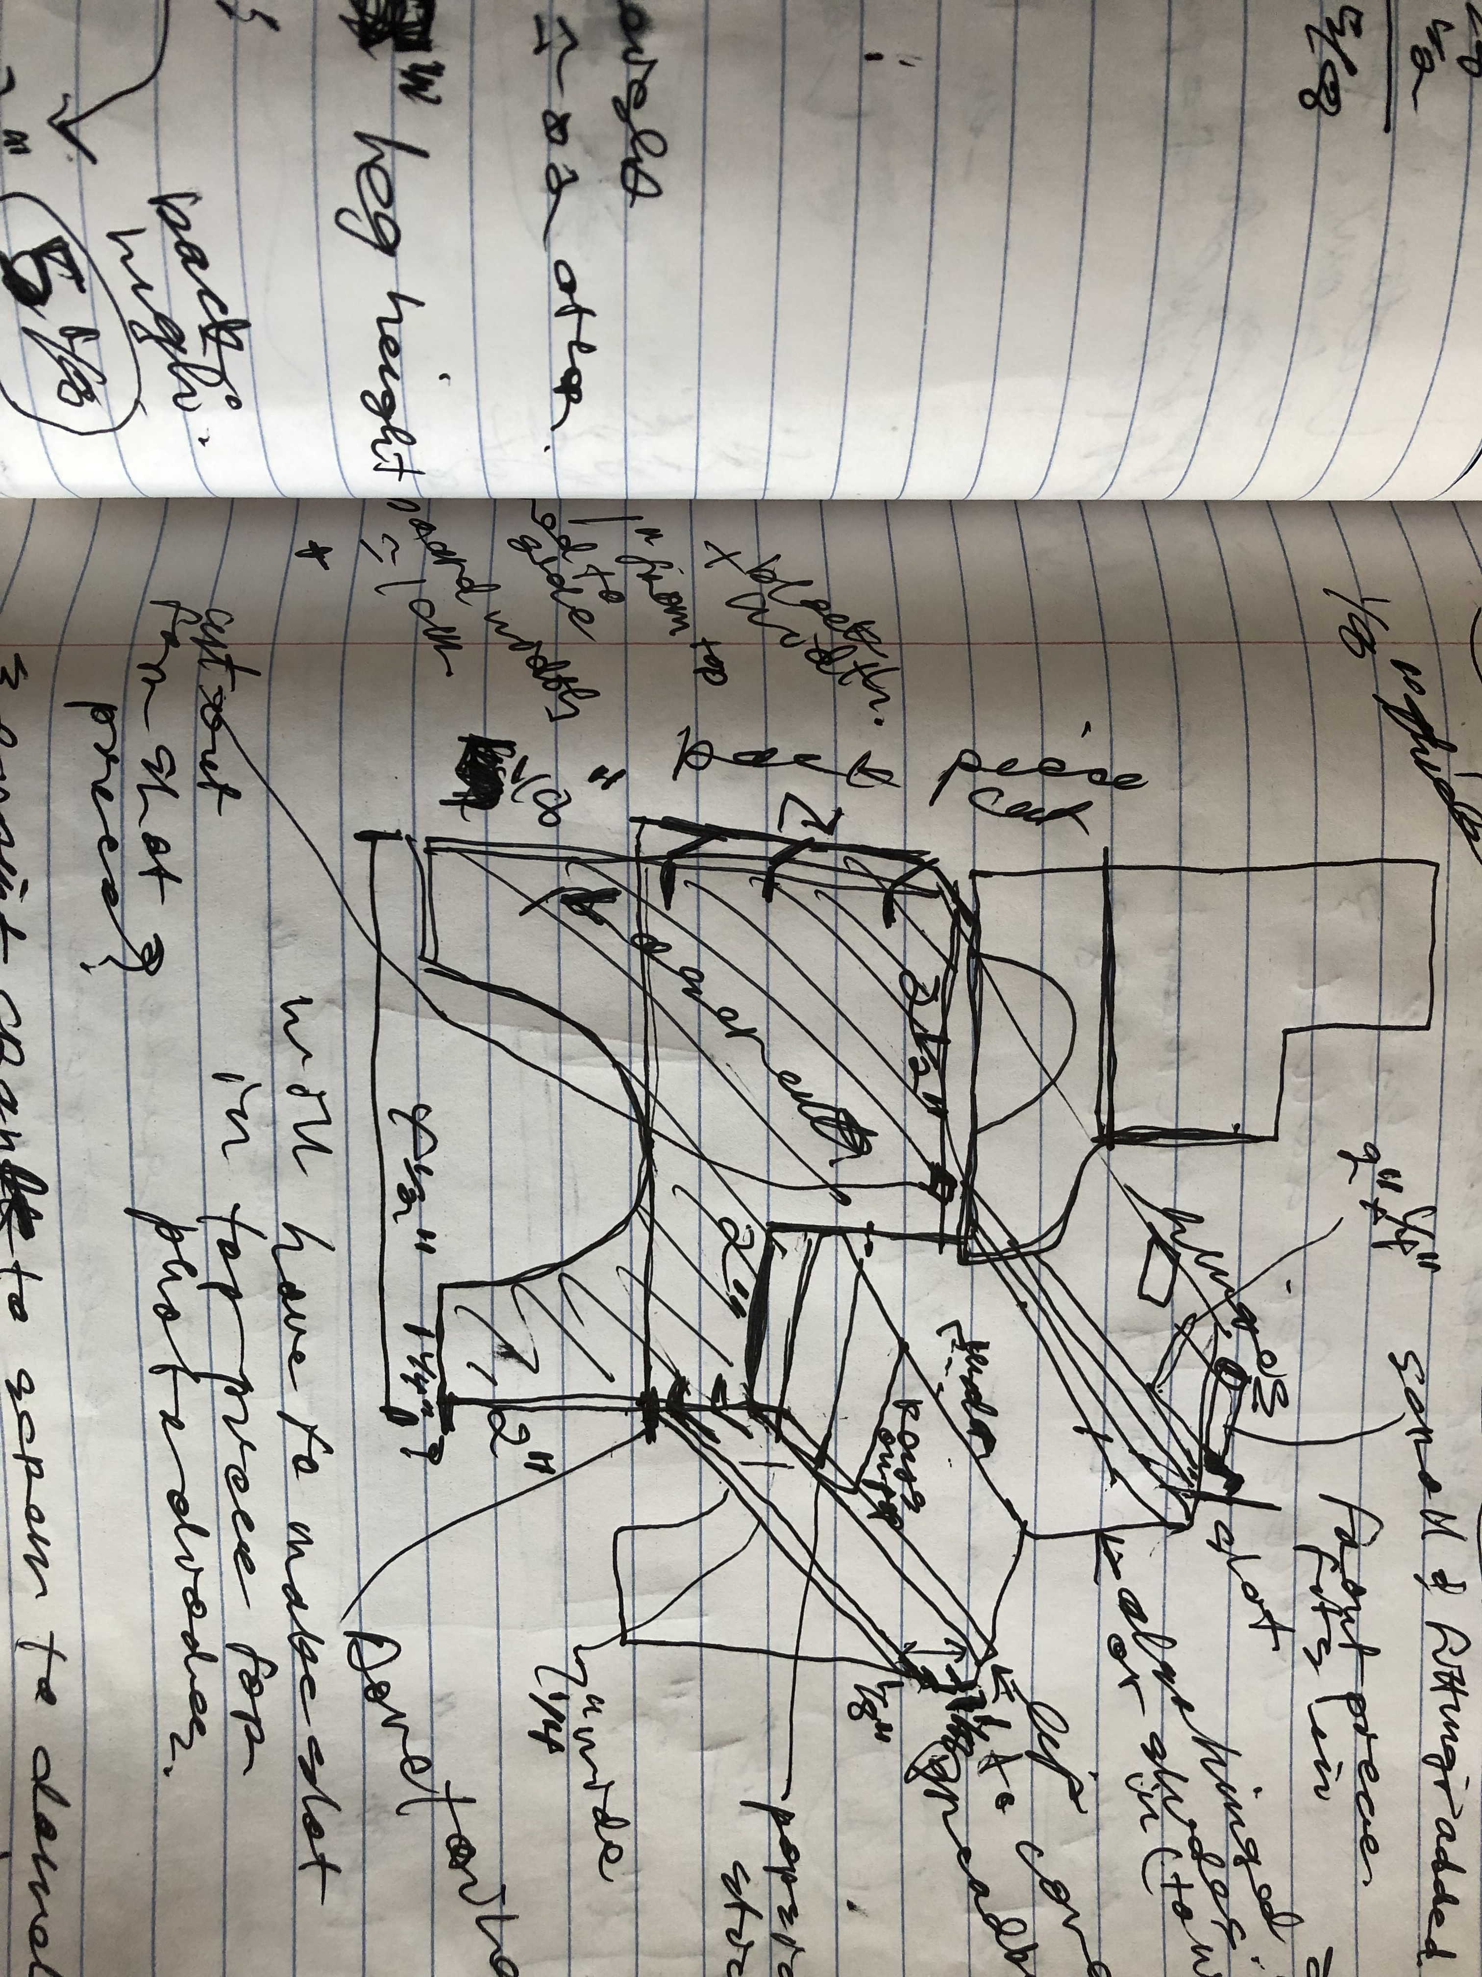
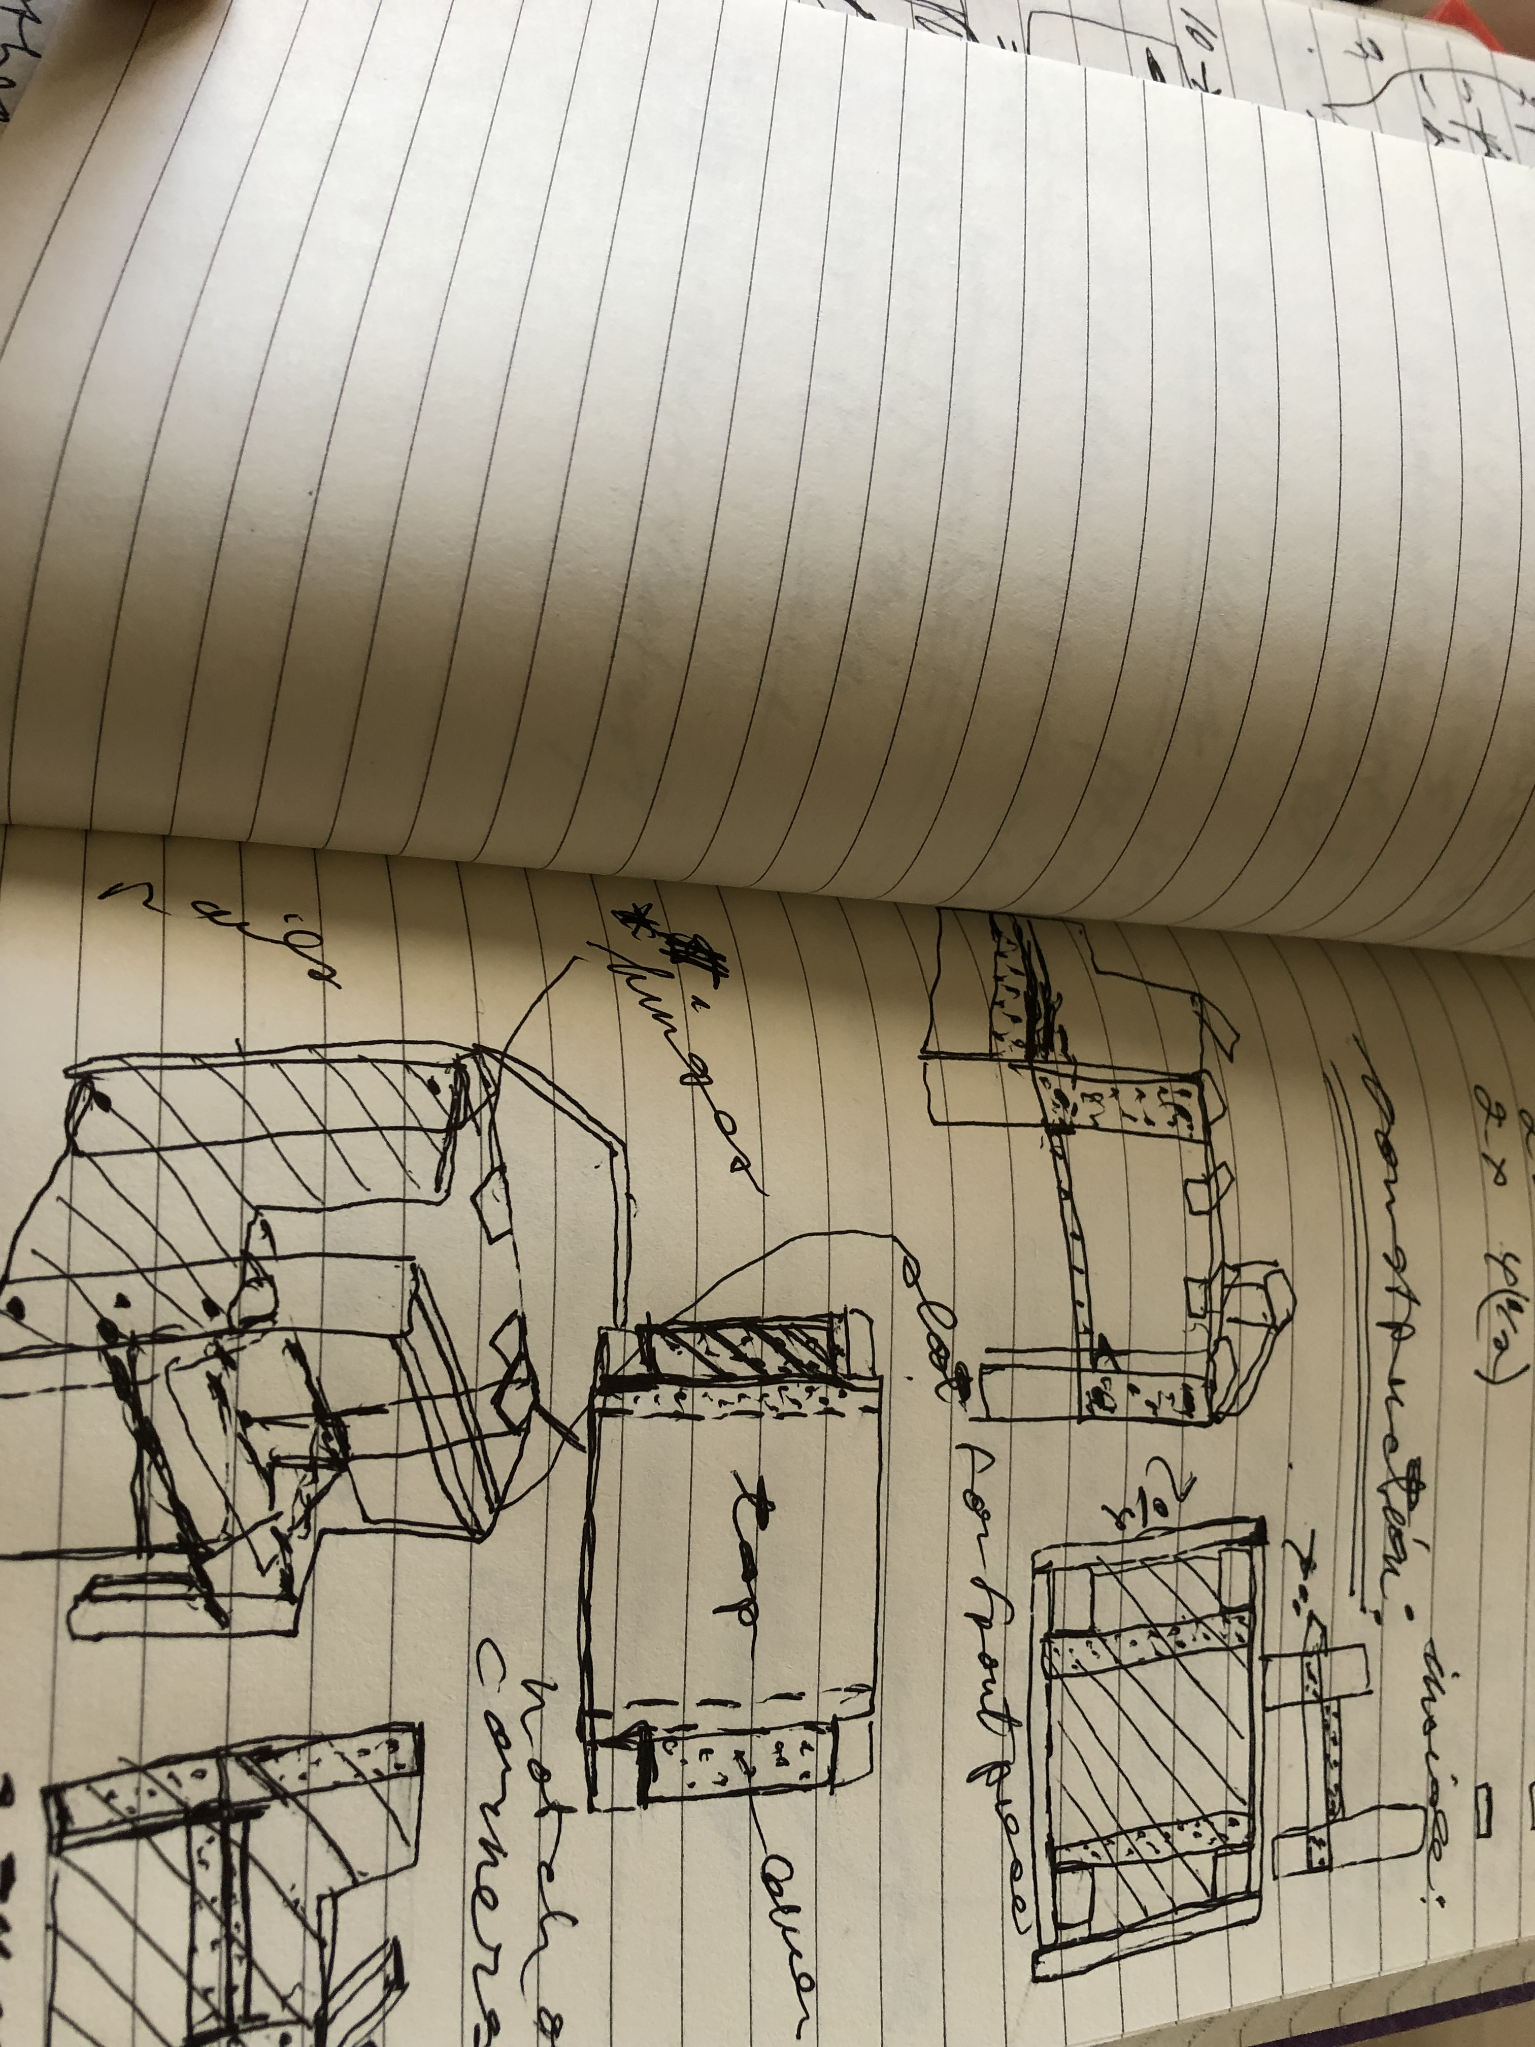
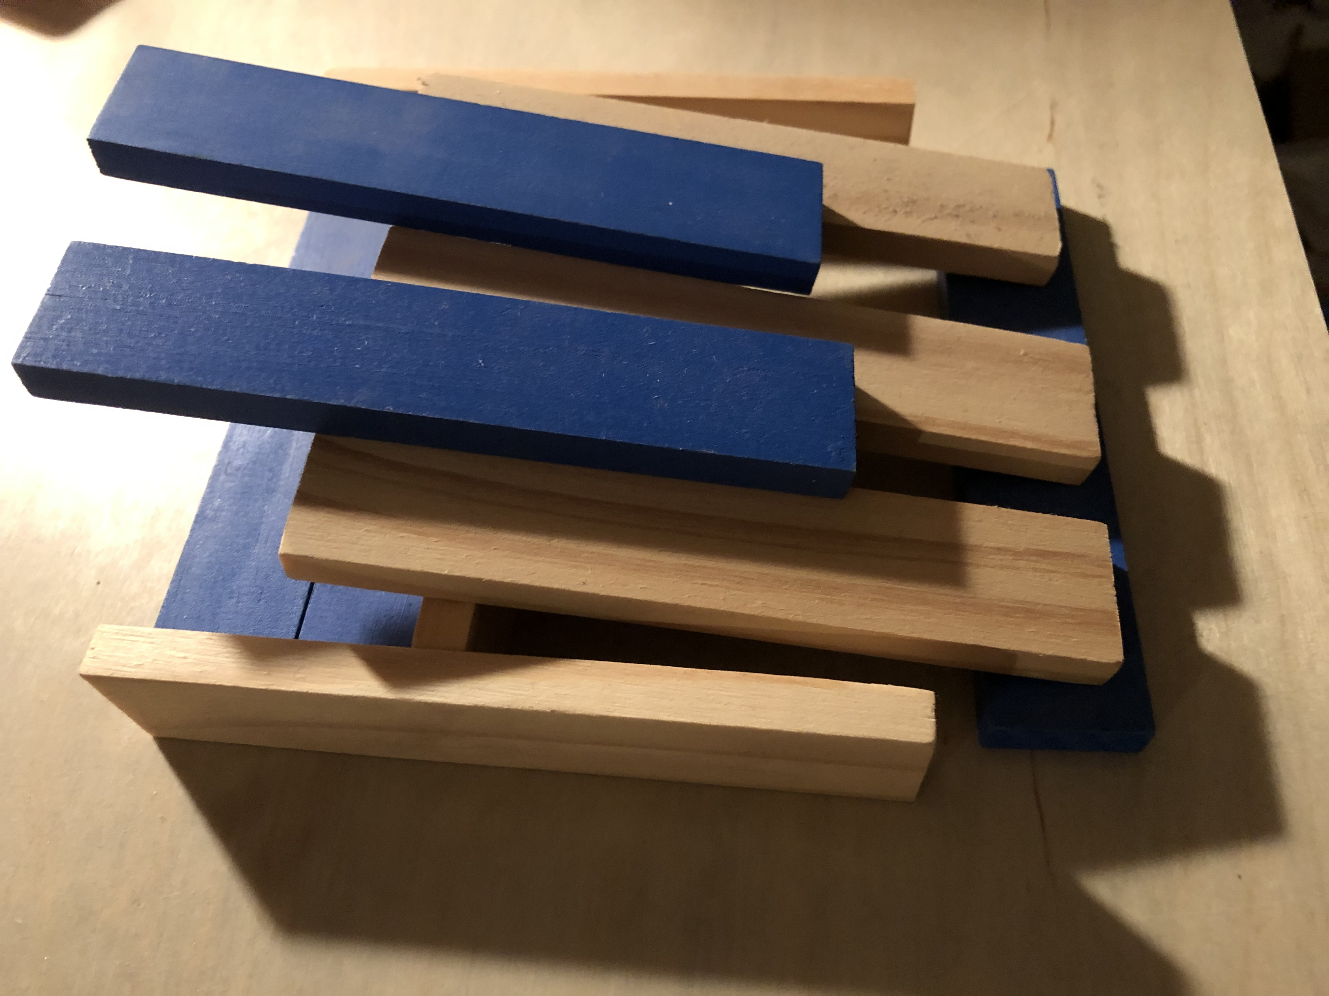
Challenges: Planning ahead sizes, designing mechanism…..

Slide 8
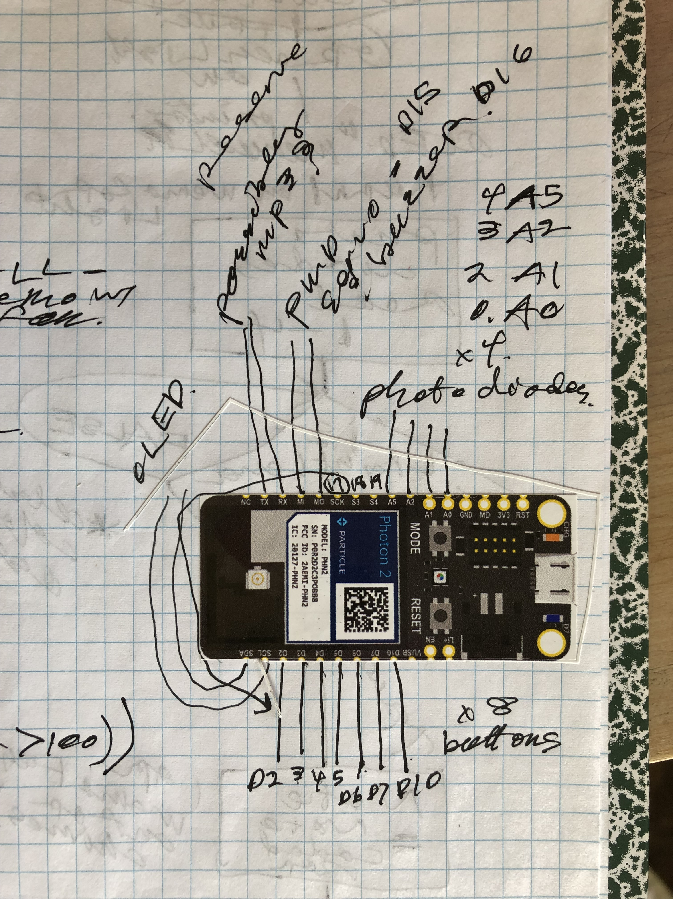
Space
Running out of pins:
Soft PWM? Drivers?

Slide 9
And of course, Code!

Slide 10
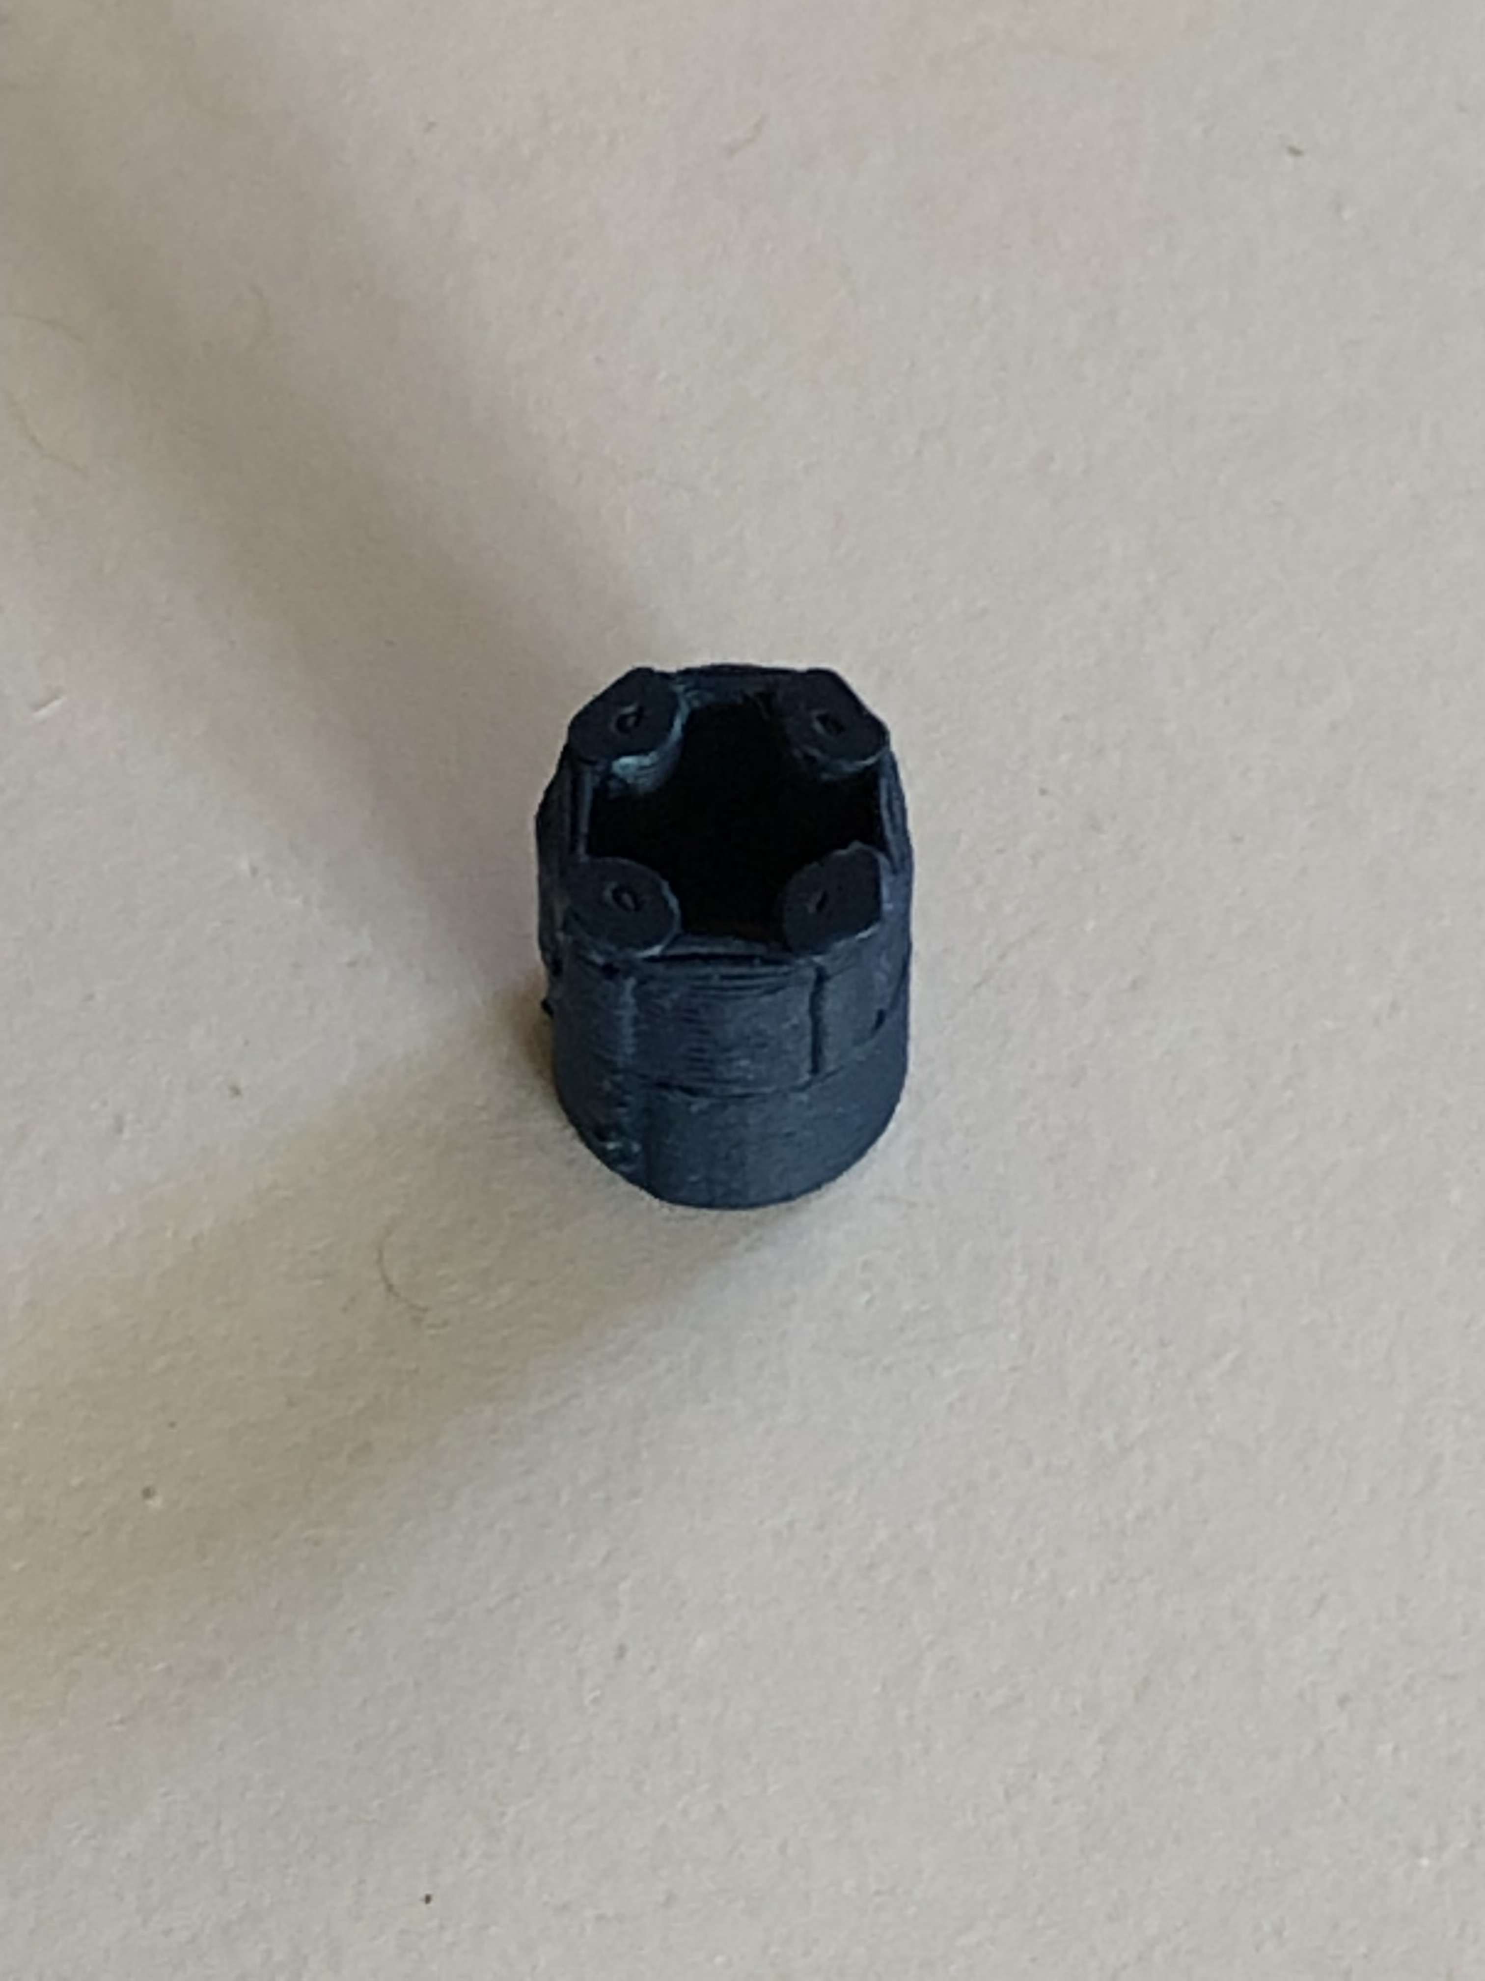
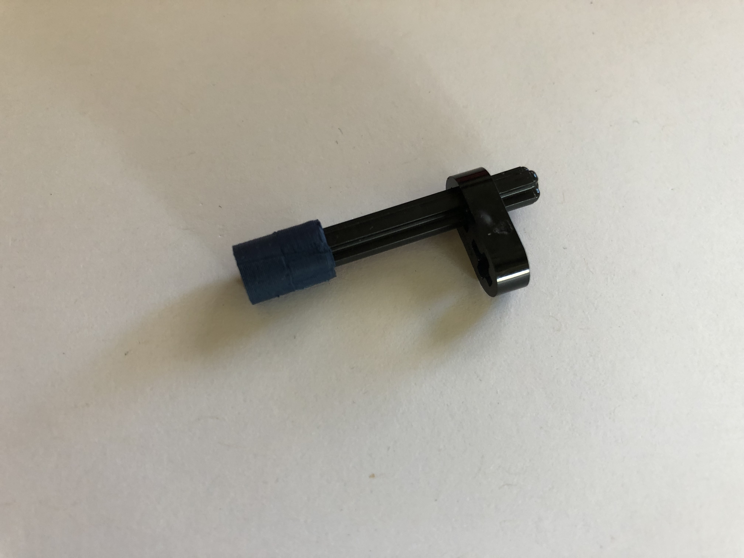
BIG (tiny) SUCCESS!
Fits perfectly!!!

